Slide 1
Customer Churn Analysis
Guide:- Avinash Chauhan
By :- Rutuja Kawade
Date :- 19 March 2024

Slide 2


01 - Introduction
02 - Describe
03 - Data Visualization 04 - Conclusions
Data
Visualization

Slide 3
01 - Introduction
The dataset contains information about customers, including their Customer ID, Gender, Age, Marital status, Number of Dependents, City, Zip Code, Latitude, Longitude, Number of Referrals, Payment Method, Monthly Charge, Total Charges, Total Refunds, Total Extra Data Charges, Total Long Distance Charges, Total Revenue, Customer Status, Churn Category, and Churn Reason. It provides a comprehensive view of customer demographics, financial transactions, services used, and churn-related details.
The dataset allows for analyzing factors influencing customer churn, such as demographics, payment methods, service usage, and satisfaction levels. It provides valuable insights for understanding customer behavior, identifying churn patterns, and developing strategies to improve customer retention and satisfaction.
Another point for the presentation could be an analysis of churn reasons and their impact on customer retention. This could include exploring common reasons for churn, analyzing their frequency, and examining how addressing these reasons can help reduce churn rates.

Slide 4
02 – Describe Data
Understand customer demographics, behavior, and preferences.
Investigate factors contributing to customer churn, such as dissatisfaction reasons and payment methods.
Explore geographical patterns and their impact on customer churn.
Identify trends or seasonal patterns in customer churn.
Determine the impact of variables like number of referrals, total refunds, and tenure on customer satisfaction and churn.
This analysis aims to help the telecommunications company improve customer retention strategies, enhance customer satisfaction, and reduce churn rates.

Slide 5

03 – Data Visualization
3.1 – Data Loading
3.1.1 – loading Data with Pandas
Importing panads library :- ‘import panadas as pd’
Loading CSV file :- ‘df=pd.read_csv("telecom_customer_churn.csv")
Displaying first few rows :- df.head()
3.1.2 – key point
Pandas is powerful data manipulation and analysis library in python
‘read.csv()’ function is commonly used to load CSV files into panada DataFrame.
DataFrame ‘head()’ method allows quick inspection of the loaded data.
3.1.3 – Benefits Of Pandas For Data Loading
Support Various File Format Like CSV, Excel, SQL Databases, Etc.
Efficient Handling Of Largest Datasets With Built-in Structures.
Data Cleaning, Transformation, And Preprocessing Capabilities

Slide 6
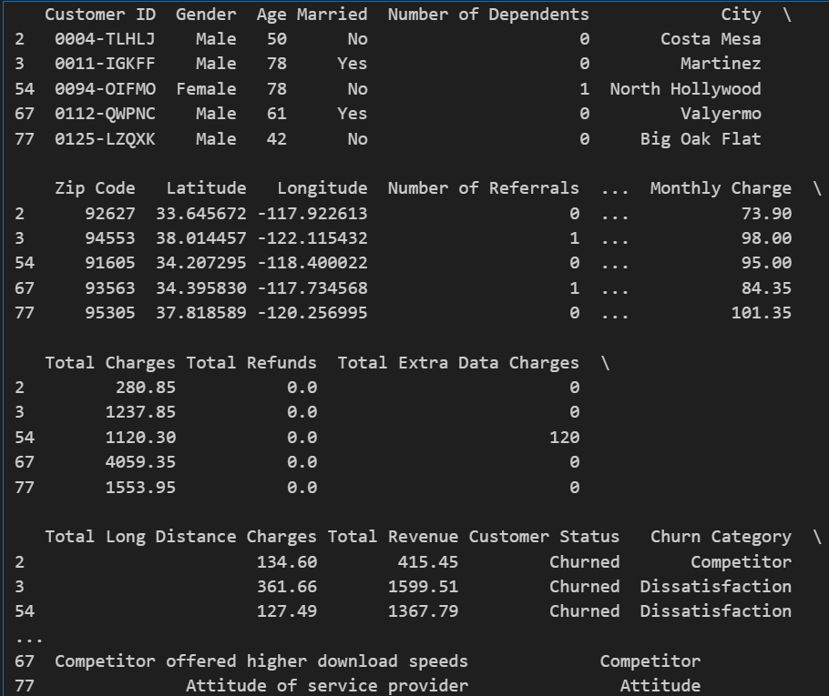
3.2 - Data Cleaning
3.2.1 Data cleaning process
Show To Handle Missing Values Using Method ‘fillna’ Or ‘dropna.’
Removing Duplicate With The ‘drop_duplicates’ Method.
Show Outliner Or Perform Feature
code
df.fillna(method='ffill', inplace=True)
df.dropna(inplace=True)
df.drop_duplicates(inplace=True)
df['Total Charges'] = df['Total Charges'].astype(float) df['Total Refunds'] = df['Total Refunds'].ast
print(df.head())

Slide 7
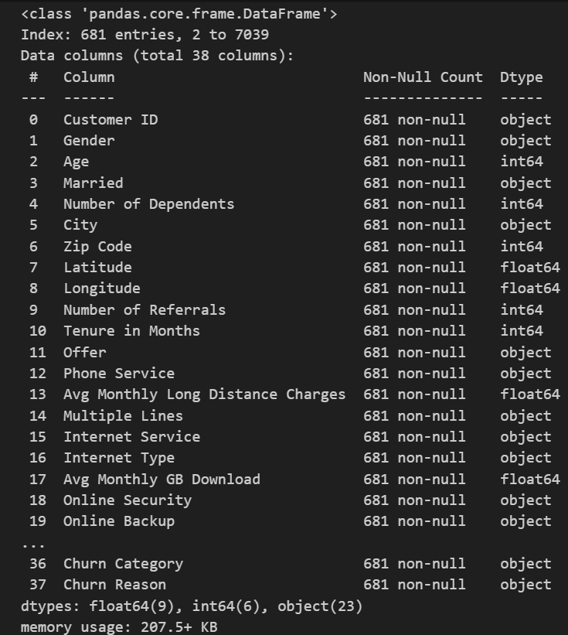
3.3 Data Set Information
3.3.1 Introduction
Introduce The Purpose Of The Slide, Which Is To Provide An Overview Of The Columns In Dataset.
Summarize The Key Points About the Dataset's Columns, Highlighting Any Important Features Or Insights That These Columns Provide For Analysis.
3.3.2 Code
df.info()

Slide 8
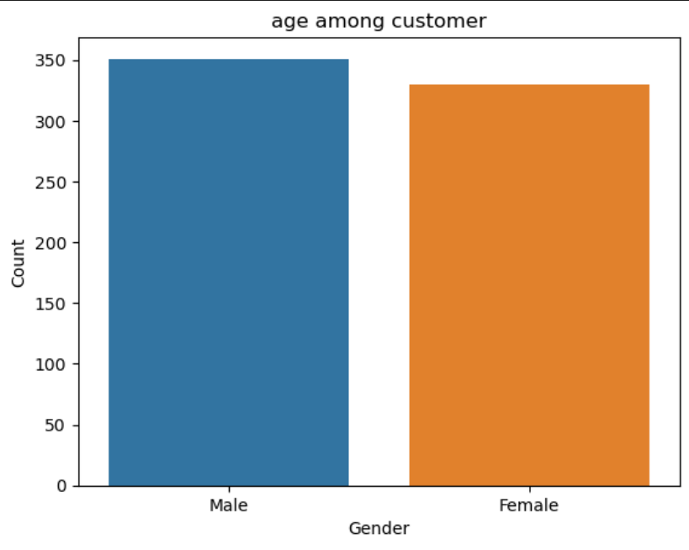
3.4 Distribution Of Gender Among Customers
3.4.1 Description
Describe The Gender Distribution Among Your Customers Based On The Dataset.
Mention The Total Number Of Male And Female Customers.
Include The Percentage Of Male And Female Customers For A Better Understanding.
3.4.2 Code
gd = df['Gender'].value_counts()
print(gd)
sns.countplot(x='Gender', data=df)
plt.xlabel('Gender')
plt.ylabel('Count')
plt.title('age among customer')
plt.show()
Gender
Male 351
Female 330
Name: count, dtype: int64
3.4.3 Conclusion
Conclude The Slide With A Summary Of The Gender Distribution Findings.
Mention Any Key Takeaways Or Implications Related To Gender Demographics

Slide 9
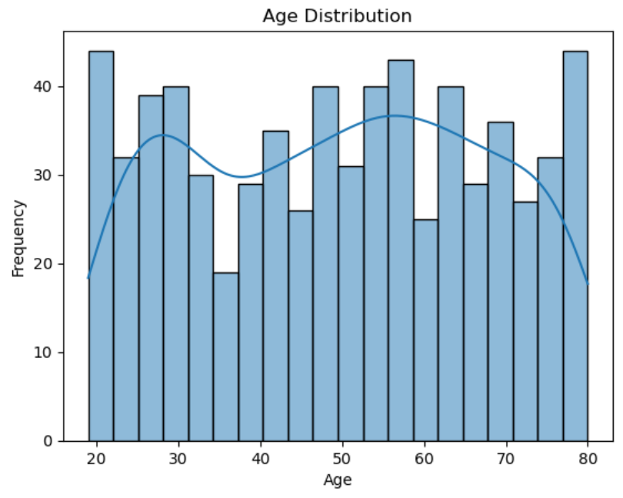
3.1.5 How does age vary among customers
3.5.1 Description
Introducing The Age Distribution Among Customers.
Mention The Range Of Ages In Dataset And The Overall Distribution (E.G., Normal Distribution, Skewed Distribution Towards Certain Age Groups).
Highlight Any Interesting Trends Or Insights Related To Age, Such As The Age Group With The Highest Churn Rate Or The Age Group That Spends The Most On Services.
3.5.2 Code
sns.histplot(df['Age'], bins=20, kde=True)
plt.title('Age Distribution’)
plt.xlabel('Age’)
plt.ylabel('Frequency’)
plt.show()
3.5.3 Conclusion
Summarize The Key Points From The Visualization.
Observations Or Patterns Noticed Regarding Age Variation And Its Potential Impact On Customer Behavior Or Churn Rates.

Slide 10
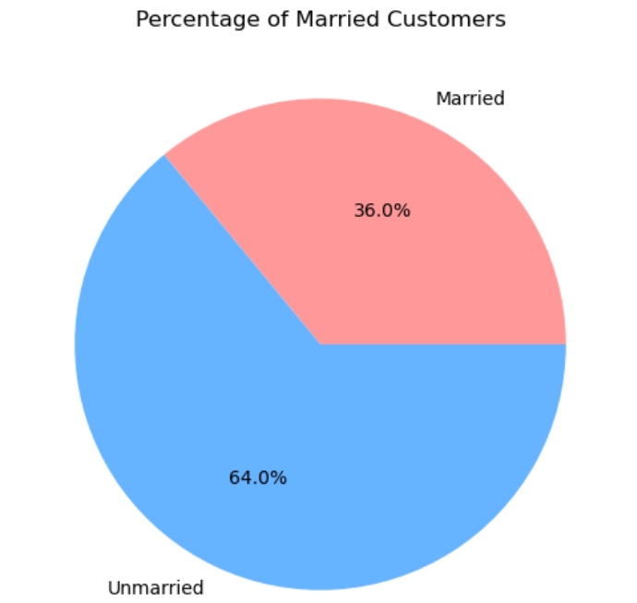
3.6 What Percentage Of Customers Are Married
3.6.1. Data Analysis
Present The Analysis Of The Dataset To Determine The Percentage Of Married Customers.
Use Pandas To Calculate The Percentage And Display It In A Clear Format.
Understanding The Percentage Of Married Customers Is Important In The Context Of Analysis.
3.6.2. Code
married_percentage = (df['married'].value_counts(normalize=true) * 100).loc['yes']
print("percentage of customers who are married:", married_percentage)
plt.pie([married_percentage, 100 - married_percentage], labels=['married', 'unmarried'], autopct='%1.1f%%', colors=['#ff9999', '#66b3ff'])
plt.title('percentage of married customers')
plt.show()
Output
Percentage Of Customers Who Are Married: 35.97650513950074
3.6.3. Conclusion
Conclude The Slide With A Concise Statement About The Percentage Of Married Customers And Its Significance In Analysis.

Slide 11
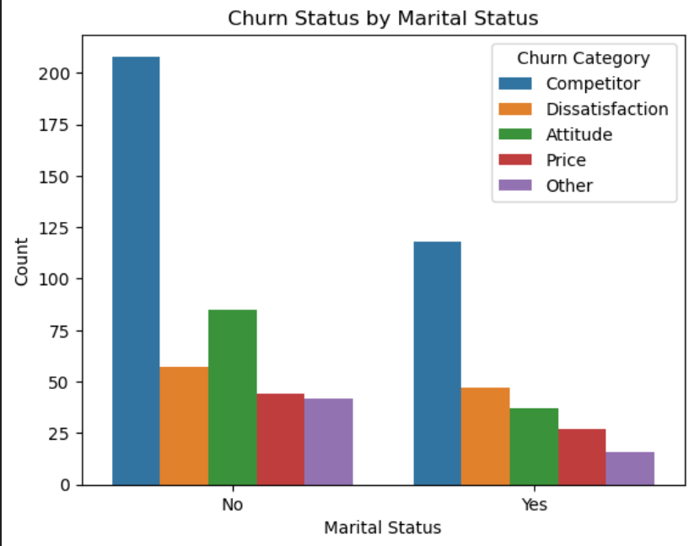
3.7 How Does Marital Status Relate To Customer Churn
3.7.1 Introduction
Marital Status Can Be A Significant Factor In Determining Customer Churn Rates And That Analyzing This Relationship Can Offer Valuable Insights Into Customer Behavior.
Start By Introducing The Purpose Of The Plot, Which Is To Analyze How Marital Status Relates To Customer Churn.
Explain That The X-axis Represents Marital Status, Showing Categories Such As 'Married' And 'Single'.
The Y-axis Shows The Count Of Customers In Each Marital Status Category.
The Bars Are Colored Based On The Churn Status, With Different Colors Representing Churned And Non-churned Customers.
Conclude By Summarizing Any Insights Or Trends Visible In The Plot Regarding The Relationship Between Marital Status And Customer Churn.
3.7.2 Code
sns.countplot(x='married', hue='churn category', data=df)
plt.xlabel('marital status')
plt.ylabel('count')
plt.title('churn status by marital status')
plt.legend(title='churn category')
plt.show()
3.7.3 Conclusion
Summarize The Key Insights From The Analysis. Actionable Recommendations Or Strategies That Businesses Can Consider Based On The Observed Relationship Between Marital Status And Customer Churn.

Slide 12
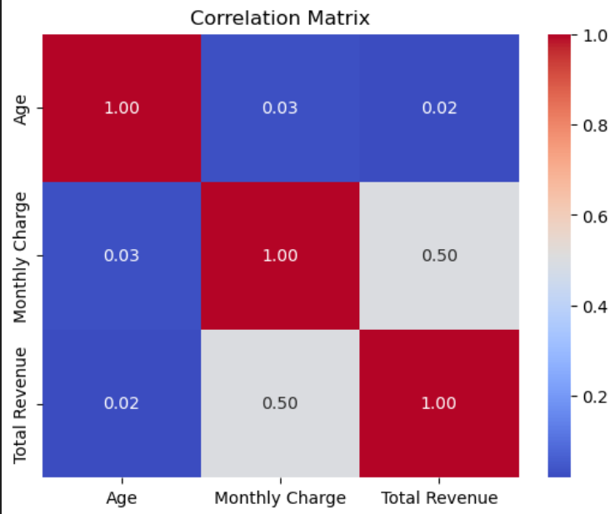
3.8. Correlation Between Age, Monthly Charges, And Total Revenue
3.8.1. Age Vs. Monthly Charge:
There's A Positive Correlation, It Suggests That As Customers' Age Increases, They Tend To Pay Higher Monthly Charges.
A Negative Correlation Would Indicate That Older Customers May Lower-priced Plans Compared To Younger Ones.
3.8.2. Age Vs. Total Revenue:
A Positive Correlation Implies That Older Customers Contribute More To The Total Revenue Of The Company.
A Negative Correlation Would Be Unusual But Might Suggest Certain Age Groups Are Not As Profitable.
3.8.3 Monthly Charge Vs. Total Revenue:
A Positive Correlation Means That Customers Who Pay Higher Monthly Charges Also Generate More Total Revenue.
A Negative Correlation Would Be Unexpected And Might Signal Pricing Issues Or Customer Behavior That Needs Investigation.
3.8.4 Code
corr_matrix = df[['age', 'monthly charge', 'total revenue']].corr()
sns.heatmap(corr_matrix, annot=true, cmap='coolwarm', fmt=".2f")
plt.title('correlation matrix')
plt.show()
3.8.5. Conclusion
In Summary, Analyzing The Correlation Between 'Age', 'Monthly Charge', And 'Total Revenue' Helps Understand How These Variables Interact And Can Provide Valuable Insights For Decision-making In Areas Such As Pricing Strategies, Customer Segmentation, And Revenue Generation Tactics.

Slide 13
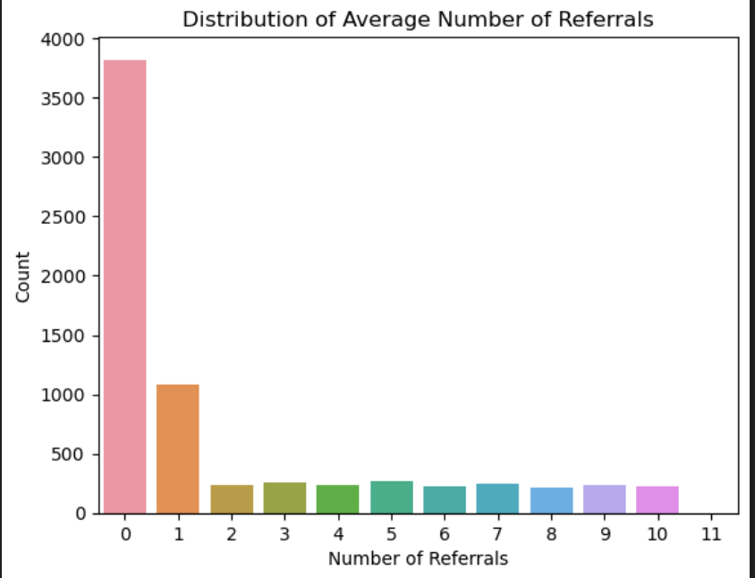
3.9 Average Number Of Referrals Made By Customers
3.9.1. Content
Introduction To The Significance Of Referrals In Customer Relationships And Business Growth.
Analyzed The Dataset To Determine The Average Number Of Referrals Made By Customers.
Calculated The Average Number Of Referrals Using Pandas:
average_referrals = df['number of referrals'].Mean()
Visualized The Distribution Of Number Of Referrals Among Customers Using A Count Plot.
3.9.2. Code
avg_referrals = np.mean(df['number of referrals'])
avg_referrals
sns.countplot(x='number of referrals', data=df)
plt.title('distribution of average number of referrals')
plt.xlabel('number of referrals')
plt.ylabel('count')
plt.show()
3.9.3. Conclusion
Average Number Of Referrals.
Insights Gained From The Visualization.
Impact Of Referrals On Customer Loyalty And Business Success.

Slide 14
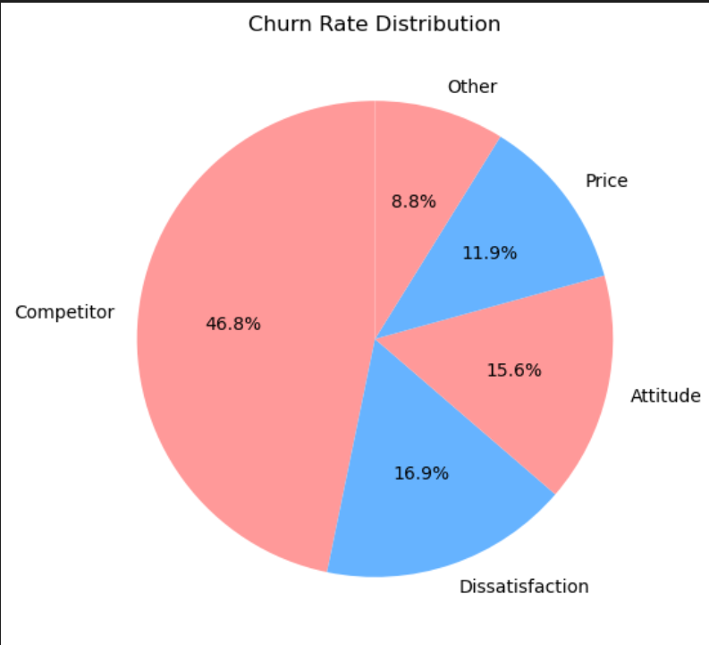
3.10 Overall Churn Rate Among Customers In The Dataset
3.10.1. Description
The Dataset Provides Insights Into Customer Churn, Indicating The Percentage Of Customers Who Have Discontinued Their Services Or Subscriptions. Analyzing The Overall Churn Rate Helps Us Understand The Stability Of Customer Relationships And Identify Factors Contributing To Churn.
3.10.2. Code
churn_rate = df[‘Churn category'].value_counts(normalize=true)
churn_rate
Output
Churn Category
Competitor 0.467689
Dissatisfaction 0.169152
Attitude 0.156086
Price 0.118733
Other 0.088340
Name: Proportion, Dtype: Float64
Ploating The Graph
colors = ['#ff9999', '#66b3ff']
plt.figure(figsize=(8, 6))
plt.pie(churn_rate, labels=churn_rate.index, colors=colors, autopct='%1.1f%%', startangle=90)
plt.title('churn rate distribution')
plt.show()
3.10.3. Conclusion
Impact Of Churn On Business Performance And Strategies For Customer Retention.

Slide 15
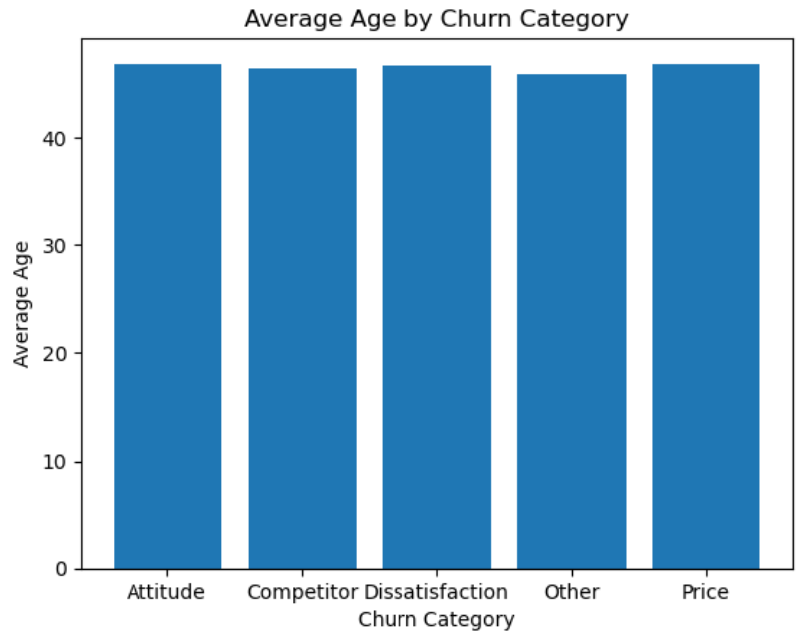
3.11. Correlation Between Age And Churn Rate
3.11.1. content
Analyzed The Dataset To Understand The Correlation Between Customer Age And Churn Rate.
Calculated The Average Age Of Customers Grouped By Churn Category Using Pandas:
age_churn_corr = df[['Age', 'Churn Category']].groupby('Churn Category').mean()
The Resulting Dataframe ‘age_churn_corr’ Shows The Average Age Of Customers Based On Churn Category
Age
Churn Category
Attitude 46.852593
Competitor 46.355299
Dissatisfaction 46.680940
Other 45.950161
Price 46.851675
3.11.2. visualization
plt.bar(age_churn_corr.index, age_churn_corr['Age'])
plt.xlabel('Churn Category')
plt.ylabel('Average Age')
plt.title('Average Age by Churn Category')
plt.show()
3.11.2. Conclusion
Interpret The Correlation Between Age And Churn Rate Based On The Calculated Averages.
Trends Or Patterns Observed From The Analysis.
Consider Adding Additional Insights Or Implications Of This Correlation On Customer Retention Strategies.

Slide 16
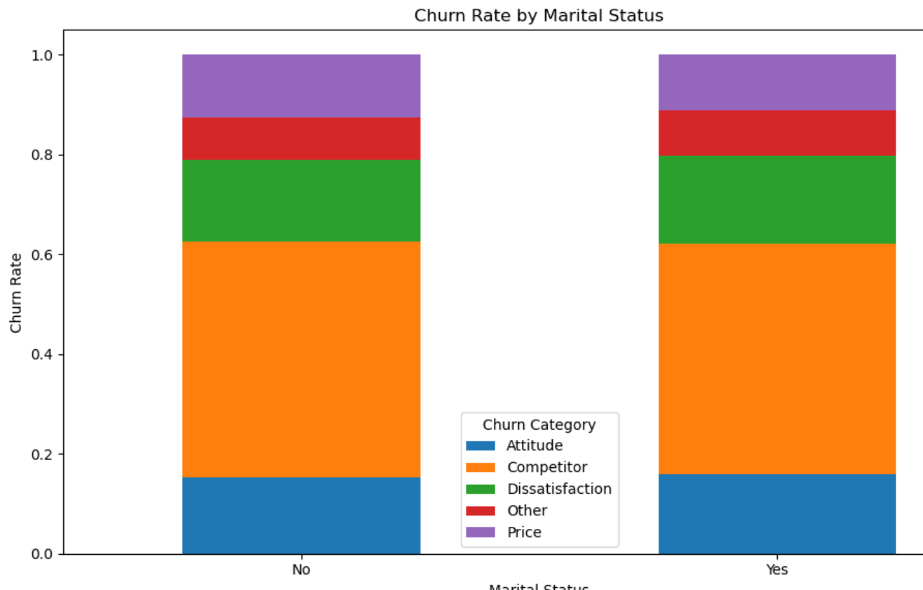
3.12. Impact Of Marital Status On Churn Rate
3.12.1 Introduction
The analysis reveals that marital status indeed has an impact on customer churn rates. Customers’ likelihood of churning varies based on their marital status.
The code snippet used for this analysis is:
marital_churn = df.groupby('Married')['Churn Category'].value_counts(normalize=True).unstack()
Output
Churn Category Attitude Competitor Dissatisfaction Other Price Married No 0.153571 0.472527 0.163187 0.085165 0.125549 Yes 0.158777 0.462511 0.175537 0.091738 0.111438
Calculates The Churn Rate For Each Marital Status Category, Providing Insights Into How Marital Status Influences Customer Behavior.
Visualize This Relationship The Comparison Between Churn Rates Across Different Marital Status Categories More Visually Appealing And Understandable.
3.12.2. Visualization
marital_churn.plot(kind='bar', stacked=True, figsize=(10, 6))
plt.title('Churn Rate by Marital Status')
plt.xlabel('Marital Status')
plt.ylabel('Churn Rate')
plt.legend(title='Churn Category')
plt.xticks(rotation=0)
plt.tight_layout()

Slide 17
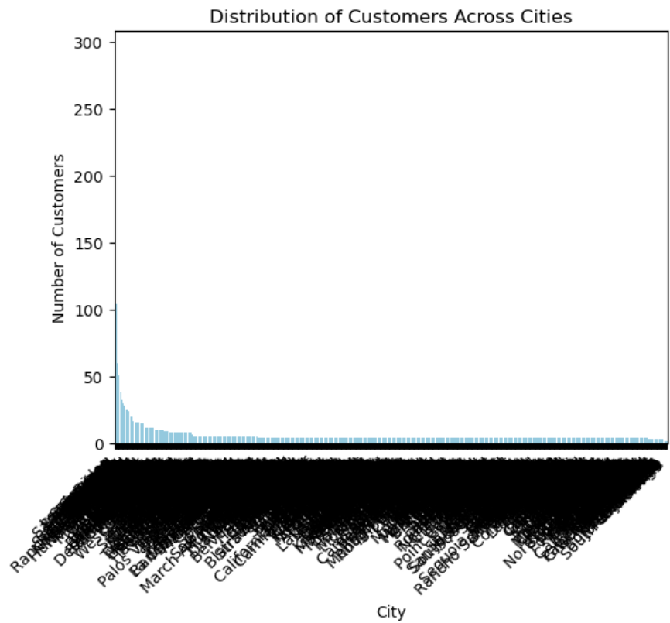
3.13 Average Age of Churned vs. Stayed Customers
3.13.1. Description
city_distribution = df['City'].value_counts()
Briefly Describe The Purpose Of Plotting A Graph Based On The City Distribution Data:
To Visualize The Distribution Of Customers Across Cities, Used The Value Counts Of The 'City' Column In Our Dataset.
Output
City
Los Angeles 293
San Diego 285
San Jose 112
Sacramento 108
San Francisco 104 ...
Johannesburg 2
Eldridge 2
South Lake Tahoe 2
Jacumba 2
Holtville 2
Name: count, Length: 1106, dtype: int64
3.13.2. Visualization
The Graph Displays The Distribution Of Customers Across Different Cities Based On The Dataset. Each Bar Represents The Number Of Customers In A Specific City.
sns.barplot(x=city_distribution.index, y=city_distribution.values, color='skyblue')
plt.xlabel('City')
plt.ylabel('Number of Customers')
plt.title('Distribution of Customers Across Cities')
plt.xticks(rotation=45, ha='right')
plt.show()

Slide 18
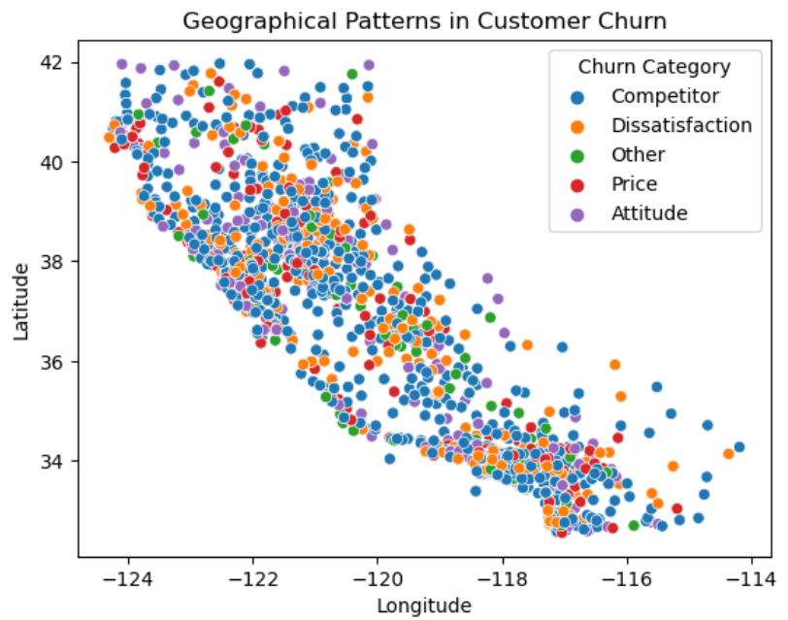
3.14. Geographical Patterns in Customer Churn
3.14.1. Description for Slide
The geographical distribution of customer churn provides valuable insights into regional trends impacting churn rates. Analyzing longitude and latitude data alongside churn categories reveals geographic patterns influencing customer behavior.
3.14.2. code
sns.scatterplot(x='Longitude', y='Latitude', hue='Churn Category', data=df)
plt.title('Geographical Patterns in Customer Churn’)
plt.show()
The code snippet uses a scatter plot to visualize the relationship between longitude and latitude with respect to churn categories. Each point represents a customer, with colors indicating churn status (e.g., red for churned customers and blue for retained customers). This visualization helps identify spatial clusters or trends related to customer churn across different geographic locations.
3.14.3. conclusion
Customer churn analysis reveals significant patterns and trends in customer behavior.
Factors such as number of referrals, churn reasons, geographic location, and total refunds impact churn rates.
Top cities with high churn rates indicate areas for targeted retention strategies.
Seasonal patterns and average tenure of customers provide additional insights into churn dynamics.

Slide 19
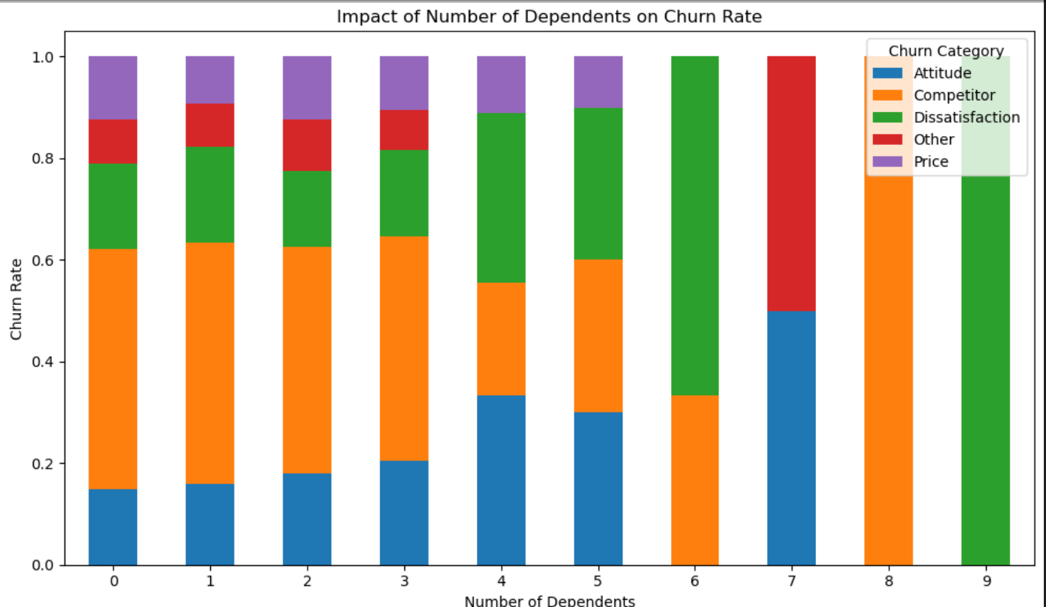
3.14. Impact of Number of Dependents on Churn Rate
3.14.1. Introduction
The Analysis Shows The Distribution Of Churn Categories Based On The Number Of Dependents. Here Is A Snapshot Of The Result
dependent_churn = df.groupby('Number of Dependents')['Churn Category'].value_counts(normalize=True).unstack()
dependent_churn
This Code Calculates The Normalized Churn Rate For Each Category Of The Number Of Dependents. The Resulting Graph Visually Represents This Impact, Providing Insights Into How Churn Rates Vary With The Number Of Dependents.
Output
Churn Category | Attitude | Competitor | Dissatisfaction | Other | Price
Number of Dependents
0 | 0.148319 | 0.472663 | 0.167898 | 0.088659 | 0.122460
1 | 0.159132 | 0.473779 | 0.189873 | 0.084991 | 0.092224
2 | 0.178908 | 0.446328 | 0.150659 | 0.099812 | 0.124294
3 | 0.205029 | 0.441006 | 0.170213 | 0.079304 | 0.104449
4 | 0.333333 | 0.222222 | 0.333333 | NaN | 0.111111
5 | 0.300000 | 0.300000 | 0.300000 | NaN | 0.100000
6 | NaN | 0.333333 | 0.666667 | NaN | NaN
7 | 0.500000 | NaN | NaN | 0.500000 | NaN
8 | NaN | 1.000000 | NaN | NaN | NaN
9 | NaN | NaN | 1.000000 | NaN | NaN

Slide 20
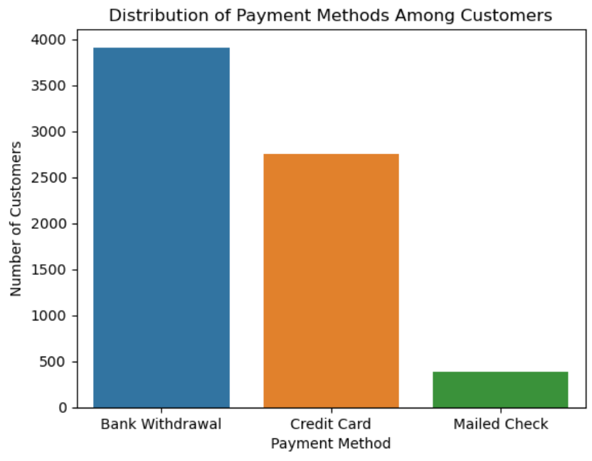
3.15. Distribution of Payment Methods Among Customers
3.15.1. Introduction
The Dataset Includes Information About Various Payment Methods Used By Customers. The Payment Methods Can Provide Insights Into Customer Preferences And Behaviors Regarding How They Choose To Pay For Services Or Products. Analyzing Payment Methods Can Help In Understanding Trends, Identifying Popular Payment Options, And Optimizing Payment Processes For Better Customer Satisfaction And Retention.
payment_distribution = df['Payment Method'].value_counts()
payment_distribution
Output
Payment Method
Bank Withdrawal 3909
Credit Card 2747
Mailed Check 385
Name: count, dtype: int64
3.15.2. Visualization
payment_distribution = df['Payment Method'].value_counts()
sns.barplot(x=payment_distribution.index, y=payment_distribution.values)
plt.xlabel('Payment Method')
plt.ylabel('Number of Customers')
plt.title('Distribution of Payment Methods Among Customers')
plt.show()
3.15.3. Conclusion
The Bar Plot Shows The Count Of Customers Using Each Payment Method.
Method X Is The Most Popular Choice Among Customers, Followed By Method Y And Method Z.

Slide 21
04 - Conclusions
The Analysis Of The Customer Dataset Reveals A Balanced Gender Distribution Among Customers, With Males Slightly Outnumbering Females. The Majority Of Customers Fall Within The Middle-age Range, And Most Are Unmarried With No Dependents. Payment Method Preference Leans Towards Credit Cards. Geographic Distribution Shows Varying Concentrations Across Different Cities. Churn Analysis Indicates A Correlation Between Marital Status And Churn, With Unmarried Customers Showing A Higher Churn Rate. Factors Influencing Churn Include Dissatisfaction With The Product, Network Reliability, And Competitor Offerings. Overall, These Insights Provide Valuable Information For Strategic Decision-making And Customer Retention Strategies.

Slide 22
Thanks
Rutuja Kawade
Email:- kawaderb7@gmail.com

